Slide 1

Analysis of Algorithms
Asymptotic Analysis
(Chapter 3, Appendix A)

Slide 2

Course Information
https://hatimalsuwat.github.io/algorithms-Spring2021.html
Communication:
  Announcements on webpage/ emails/ blackboard
  Questions? Email me.
  Staff email: hssuwat@uqu.edu.sa
Course technology:
  Website
  UQU Blackboard
  Regular homework
  Help us make it awesome!

Slide 3
Course Information
Course Website https://hatimalsuwat.github.io/algorithms-Spring2021.html
Discussion:
  Please ask any question during the lecture (don’t be shy)
  There is no such thing as a stupid question.
  Answer others’ questions - if you know the answer ;-)
  Learn from others’ questions and answers

Slide 4
Course Information
Assignments:
  Quizzes: there will be several quizzes randomly given
  Homework assignments: there will be several homework assignments during the semester.
  Exams: One Midterm Exam and One Final Exam. Closed book tests will cover the course material.
  Assignments are always due on the announced day and time. There will be a late submission penalty of 20%/day after the due date for homework and project assignments unless it is approved by the instructor. Cutoff date for assignments is 5 days after due date! Exams must be taken as scheduled except in cases of extenuating circumstances such as a documented emergency.
Participation can help on margins

Slide 5
Course Information
Grading:
  Midterm Exam: 25%
  Homework Assignments: 25%
  Participation and Quizzes: 10%
  Final Exam: 40%
Total score that can be achieved: 100

Slide 6
Course Information
Meeting time and place:
  Office: Department of Computer Science (office #1148)
  Office hours: Due to the COVID-19 pandemic restrictions, there will be no in-person office hours. Please email me if you have any question. If necessary, I will arrange a phone call or a virtual meeting
  Email: Hssuwat@uqu.edu.sa

Slide 7
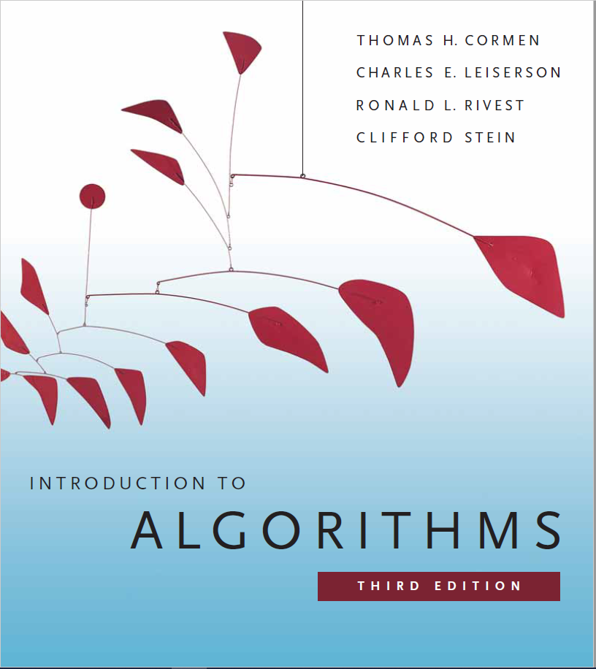
Textbook

Slide 8
Course Information: Feedback
Please give feedback positive or negative as early as you can via email.

Slide 9
Analysis of Algorithms
An algorithm is a finite set of precise instructions for performing a computation or for solving a problem.
What is the goal of analysis of algorithms?
  To compare algorithms mainly in terms of running time but also in terms of other factors (e.g., memory requirements, programmer's effort etc.)
What do we mean by running time analysis?
  Determine how running time increases as the size of the problem increases.

Slide 10
Input Size
Input size (number of elements in the input)
  size of an array
  polynomial degree
  # of elements in a matrix
  # of bits in the binary representation of the input
  vertices and edges in a graph

Slide 11
Types of Analysis
Worst case
  Provides an upper bound on running time
  An absolute guarantee that the algorithm would not run longer, no matter what the inputs are
Best case
  Provides a lower bound on running time
  Input is the one for which the algorithm runs the fastest
Average case
  Provides a prediction about the running time
  Assumes that the input is random

Slide 12
How do we compare algorithms?
We need to define a number of objective measures.
(1) Compare execution times?
Not good: times are specific to a particular computer !!
(2) Count the number of statements executed?
Not good: number of statements vary with the programming language as well as the style of the individual programmer.

Slide 13
Ideal Solution
Express running time as a function of the input size n (i.e., f(n)).
Compare different functions corresponding to running times.
Such an analysis is independent of machine time, programming style, etc.

Slide 14
Example
Associate a "cost" with each statement.
Find the "total cost“ by finding the total number of times each statement is executed.
Algorithm 1 Algorithm 2
Cost Cost
arr[0] = 0; c₁ for(i=0; i<N; i++) c₂
arr[1] = 0; c₁ arr[i] = 0; c₁
arr[2] = 0; c₁
... ...
arr[N-1] = 0; c₁
----------- -------------
c₁+c₁+...+c₁ = c₁ x N (N+1) x c₂ + N x c₁ =
(c₂ + c₁) x N + c₂

Slide 15
Another Example
Algorithm 3 Cost
sum = 0; c₁
for(i=0; i<N; i++) c₂
for(j=0; j<N; j++) c₂
sum += arr[i][j]; c₃
------------
c₁ + c₂ x (N+1) + c₂ x N x (N+1) + c₃ x N²

Slide 16
Asymptotic Analysis
To compare two algorithms with running times f(n) and g(n), we need a rough measure that characterizes how fast each function grows.
Hint: use rate of growth
Compare functions in the limit, that is, asymptotically!
  (i.e., for large values of n)

Slide 17
Rate of Growth
Consider the example of buying elephants and goldfish:
Cost: cost_of_elephants + cost_of_goldfish
Cost ~ cost_of_elephants (approximation)
The low order terms in a function are relatively insignificant for large n
n⁴ + 100n² + 10n + 50 ~ n⁴
i.e., we say that n⁴ + 100n² + 10n + 50 and n⁴ have the same rate of growth

Slide 18
Asymptotic Notation
O notation: asymptotic “less than”:
  f(n)=O(g(n)) implies: f(n) “≤” g(n)
Ω notation: asymptotic “greater than”:
  f(n)= Ω (g(n)) implies: f(n) “≥” g(n)
Θ notation: asymptotic “equality”:
  f(n)= Θ (g(n)) implies: f(n) “=” g(n)

Slide 19
Big-O Notation
We say f_{A}(n)=30n+8 is order n, or O (n)
It is, at most, roughly proportional to n.
f_{B}(n)=n²+1 is order n², or O(n²). It is, at most, roughly proportional to n².
In general, any O(n²) function is faster- growing than any O(n) function.

Slide 20
Visualizing Orders of Growth
On a graph, as
you go to the
right, a faster
growing
function
eventually
becomes
larger...
f_{A}(n)=30n+8
Value of function →
f_{B}(n)=n²+1
Increasing n →

Slide 21
More Examples …
n⁴ + 100n² + 10n + 50 is O(n⁴)
10n³ + 2n² is O(n³)
n³ - n² is O(n³)
constants
  10 is O(1)
  1273 is O(1)

Slide 22
Back to Our Example
Algorithm 1 Algorithm 2
Cost Cost
arr[0] = 0; c₁ for(i=0; i<N; i++) c₂
arr[1] = 0; c₁ arr[i] = 0; c₁
arr[2] = 0; c₁
...
arr[N-1] = 0; c₁
----------- -------------
c₁+c₁+...+c₁ = c₁ x N (N+1) x c₂ + N x c₁ =
(c₂ + c₁) x N + c₂
Both algorithms are of the same order: O(N)

Slide 23
Example (cont’d)
Algorithm 3 Cost
sum = 0; c₁
for(i=0; i<N; i++) c₂
for(j=0; j<N; j++) c₂
sum += arr[i][j]; c₃
------------
c₁ + c₂ x (N+1) + c₂ x N x (N+1) + c₃ x N² = O(N²)

Slide 24
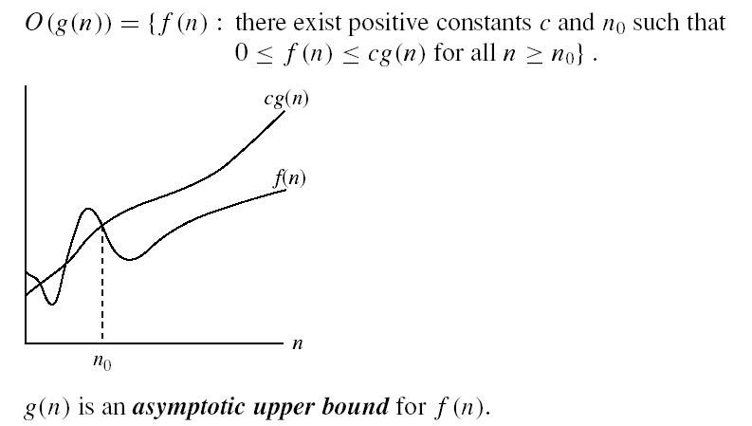
Asymptotic notations
O-notation

Slide 25
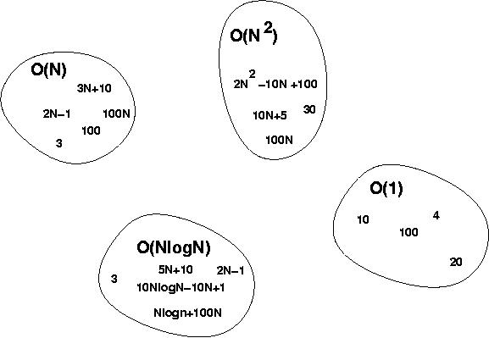
Big-O Visualization
O(g(n)) is the set of functions with smaller or same order of growth as g(n)

Slide 26
Examples
  2n² = O(n³):
  n² = O(n²):
  1000n²+1000n = O(n²):
  n = O(n²):
2n² ≤ cn³ ⇒ 2 ≤ cn ⇒ c = 1 and n₀= 2
n² ≤ cn² ⇒ c ≥ 1 ⇒ c = 1 and n₀= 1
1000n²+1000n ≤ 1000n²+ n² =1001n²⇒ c=1001 and n₀ = 1000
n ≤ cn² ⇒ cn ≥ 1 ⇒ c = 1 and n₀= 1

Slide 27
More Examples
Show that 30n+8 is O(n).
  Show ∃c,n₀: 30n+8 ≤ cn, ∀n>n₀ .
    Let c=31, n₀=8. Assume n>n₀=8. Then
    cn = 31n = 30n + n > 30n+8, so 30n+8 < cn.

Slide 28
Big-O example, graphically
Note 30n+8 isn’t
less than n
anywhere (n>0).
It isn’t even
less than 31n
everywhere.
But it is less than
31n everywhere to
the right of n=8.
cn =
31n
30n+8
30n+8
∈O(n)
Value of function →
n
n>n₀=8 →
Increasing n →

Slide 29
No Uniqueness
There is no unique set of values for n₀ and c in proving the asymptotic bounds
Prove that 100n + 5 = O(n²)
  100n + 5 ≤ 100n + n = 101n ≤ 101n²
  for all n ≥ 5
  n₀ = 5 and c = 101 is a solution
  100n + 5 ≤ 100n + 5n = 105n ≤ 105n²
  for all n ≥ 1
  n₀ = 1 and c = 105 is also a solution
  Must find SOME constants c and n₀ that satisfy the asymptotic notation relation

Slide 30
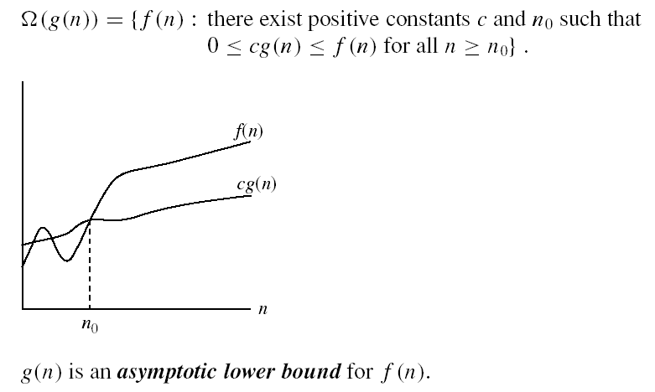
Asymptotic notations (cont.)
Ω - notation
Ω(g(n)) is the set of functions with larger or same order of growth as g(n)

Slide 31
Examples
  5n² = Ω(n)
  100n + 5 ≠ Ω(n²)
  n = Ω(2n), n³ = Ω(n²), n = Ω(logn)
  ∃ c, n₀ such that: 0 ≤ cn ≤ 5n²
⇒ cn ≤ 5n²
⇒ c = 1 and n₀ = 1
∃ c, n₀ such that: 0 ≤ cn² ≤ 100n + 5
100n + 5 ≤ 100n + 5n (∀ n ≥ 1) = 105n
cn² ≤ 105n
⇒ n(cn – 105) ≤ 0
Since n is positive ⇒ cn – 105 ≤ 0
⇒ n ≤ 105/c
⇒ contradiction: n cannot be smaller than a constant

Slide 32


Asymptotic notations (cont.)
Θ-notation
Θ(g(n)) is the set of functions with the same order of growth as g(n)

Slide 33
Examples
  n²/2 –n/2 = Θ(n²)
    ½ n² - ½ n ≤ ½ n² ∀n ≥ 0 ⇒ c₂= ½
    ½ n² - ½ n ≥ ½ n² - ½ n * ½ n ( ∀n ≥ 2 ) = ¼ n² ⇒ c₁= ¼
  n ≠ Θ(n²): c₁ n² ≤ n ≤ c₂ n²
  ⇒ only holds for: n ≤ 1/c₁

Slide 34
Examples
  6n³ ≠ Θ(n²): c₁ n² ≤ 6n³ ≤ c₂ n²
  ⇒ only holds for: n ≤ c₂ /6
  n ≠ Θ(logn): c₁ logn ≤ n ≤ c₂ logn
  ⇒ c₂ ≥ n/logn, ∀ n≥ n₀ – impossible

Slide 35
Relations Between Different Sets
Subset relations between order-of-growth sets.
R→R
O( f )
Ω( f )
• f
Θ( f )

Slide 36
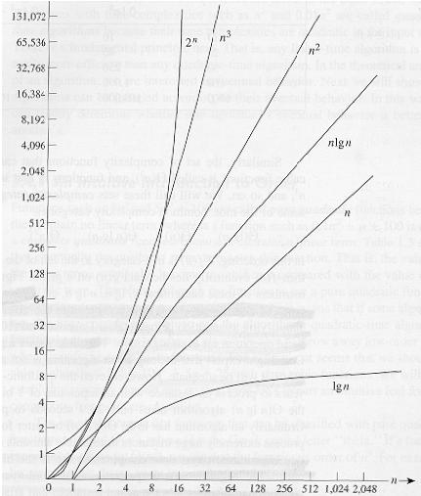
Common orders of magnitude

Slide 37
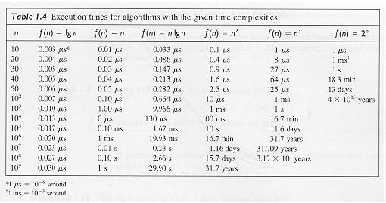
Common orders of magnitude

Slide 38
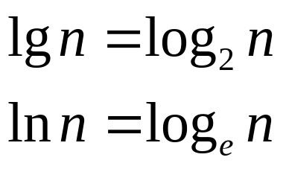
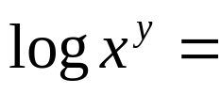



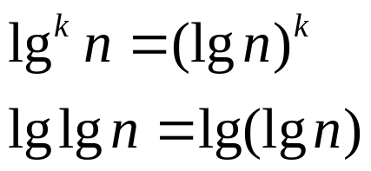
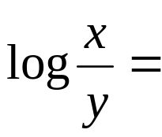




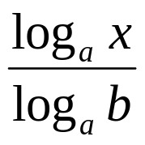
Logarithms and properties
In algorithm analysis we often use the notation “log n” without specifying the base
Binary logarithm
Natural logarithm

Slide 39
More Examples
For each of the following pairs of functions, either f(n) is O(g(n)), f(n) is Ω(g(n)), or f(n) = Θ(g(n)). Determine which relationship is correct.
  f(n) = log n²; g(n) = log n + 5
  f(n) = n; g(n) = log n²
  f(n) = log log n; g(n) = log n
  f(n) = n; g(n) = log² n
  f(n) = n log n + n; g(n) = log n
  f(n) = 10; g(n) = log 10
  f(n) = 2^{n}; g(n) = 10n²
  f(n) = 2^{n}; g(n) = 3^{n}
f(n) = Θ (g(n))
f(n) = Ω(g(n))
f(n) = O(g(n))
f(n) = Ω(g(n))
f(n) = Ω(g(n))
f(n) = Θ(g(n))
f(n) = Ω(g(n))
f(n) = O(g(n))

Slide 40
Properties
Theorem:
f(n) = Θ(g(n)) ⇔ f = O(g(n)) and f = Ω(g(n))
Transitivity:
  f(n) = Θ(g(n)) and g(n) = Θ(h(n)) ⇒ f(n) = Θ(h(n))
  Same for O and Ω
Reflexivity:
  f(n) = Θ(f(n))
  Same for O and Ω
Symmetry:
  f(n) = Θ(g(n)) if and only if g(n) = Θ(f(n))
Transpose symmetry:
  f(n) = O(g(n)) if and only if g(n) = Ω(f(n))

Slide 41
Asymptotic Notations in Equations
On the right-hand side
  Θ(n²) stands for some anonymous function in Θ(n²)
  2n² + 3n + 1 = 2n² + Θ(n) means:
  There exists a function f(n) ∈ Θ(n) such that
  2n² + 3n + 1 = 2n² + f(n)
On the left-hand side
  2n² + Θ(n) = Θ(n²)
  No matter how the anonymous function is chosen on the left-hand side, there is a way to choose the anonymous function on the right-hand side to make the equation valid.

Slide 42
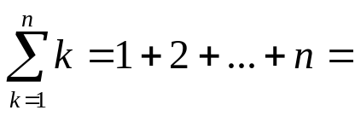
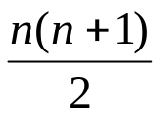
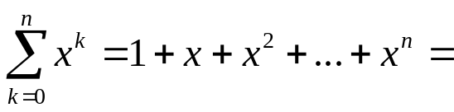
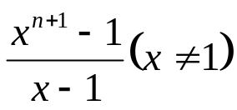
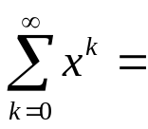
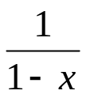
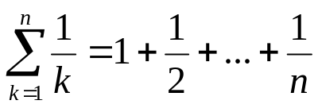

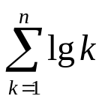

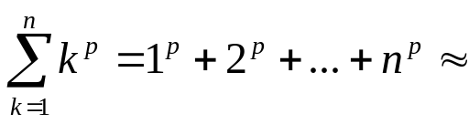
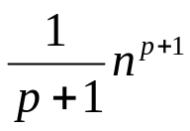
Common Summations
Arithmetic series:
Geometric series:
  Special case: |x| < 1:
Harmonic series:
Other important formulas:

Slide 43
Mathematical Induction
A powerful, rigorous technique for proving that a statement S(n) is true for every natural number n, no matter how large.
Proof:
  Basis step: prove that the statement is true for n = 1
  Inductive step: assume that S(n) is true and prove that S(n+1) is true for all n ≥ 1
Find case n “within” case n+1

Slide 44
Example
Prove that: 2n + 1 ≤ 2^{n} for all n ≥ 3
Basis step:
  n = 3: 2 ∗ 3 + 1 ≤ 2³ ⇔ 7 ≤ 8 TRUE
Inductive step:
  Assume inequality is true for n, and prove it for (n+1):
  2n + 1 ≤ 2^{n} must prove: 2(n + 1) + 1 ≤ 2^{n+1}
  2(n + 1) + 1 = (2n + 1 ) + 2 ≤ 2^{n} + 2 ≤
  ≤ 2^{n} + 2^{n} = 2^{n+1}, since 2 ≤ 2^{n} for n ≥ 1

Slide 45
Summations – Review

Slide 46
Review on Summations
Why do we need summation formulas?
  For computing the running times of iterative constructs (loops). (CLRS – Appendix A)

Slide 47
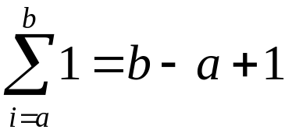
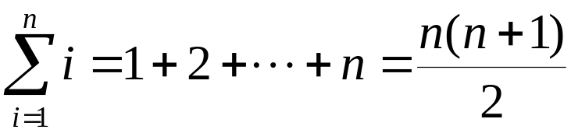
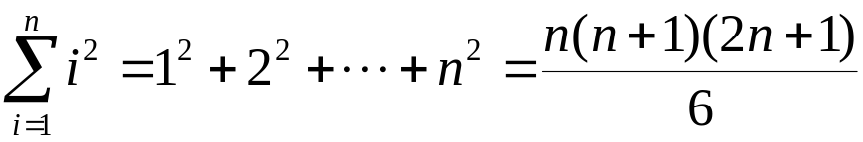
Review on Summations
Constant Series: For integers a and b, a ≤ b,
Linear Series (Arithmetic Series): For n ≥ 0,
Quadratic Series: For n ≥ 0,

Slide 48
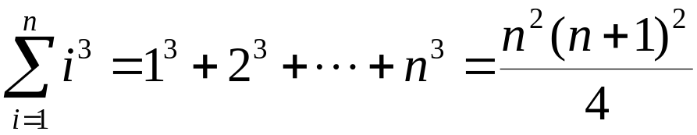
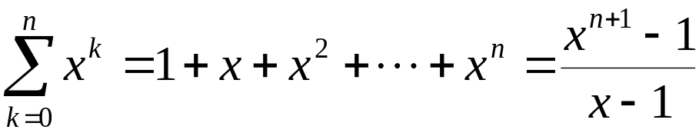
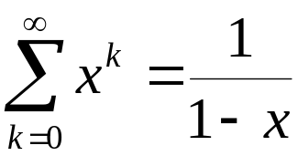
Review on Summations
Cubic Series: For n ≥ 0,
Geometric Series: For real x ≠ 1,
For |x| < 1,

Slide 49
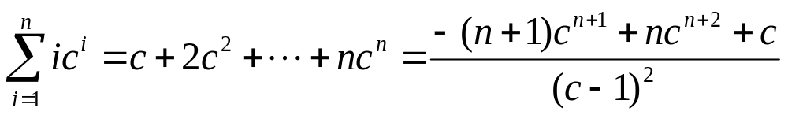
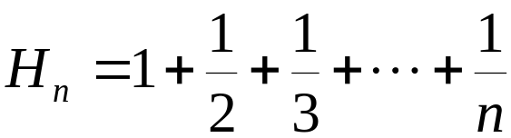
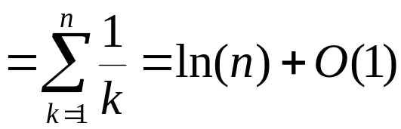
Review on Summations
Linear-Geometric Series: For n ≥ 0, real c ≠ 1,
Harmonic Series: nth harmonic number, n∈I⁺,

Slide 50
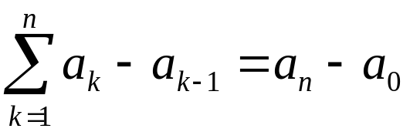
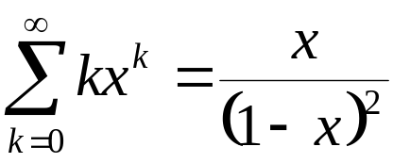
Review on Summations
Telescoping Series:
Differentiating Series: For |x| < 1,

Slide 51
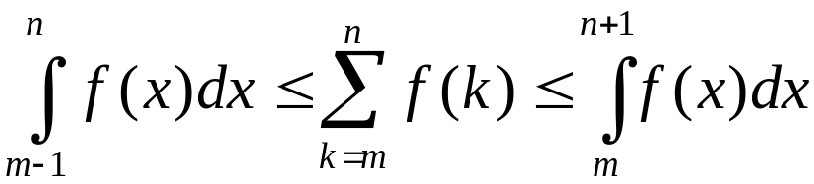
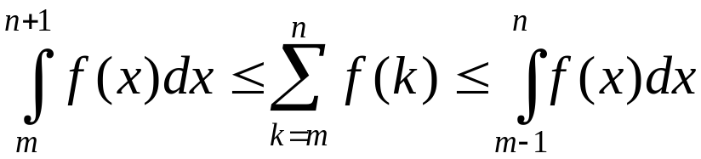
Review on Summations
Approximation by integrals:
  For monotonically increasing f(n)
  For monotonically decreasing f(n)
How?

Slide 52
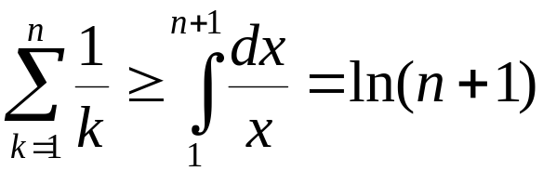
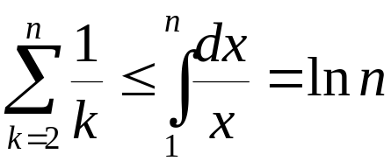
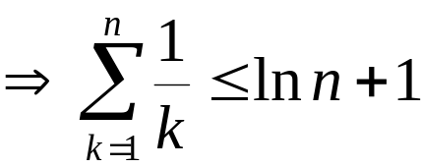
Review on Summations
nth harmonic number

